Slide 1
Spring Boot
Building 'Bootiful' Applications with Spring Boot

Slide 2
Agenda
REST principles
Micro-services
Spring Framework
Overview of Spring Boot
Philosophy, goals, features, benefits and limitations
How to?
Live Demo
Q&A

Slide 3
REST – Representational State Transfer
Introduced in Roy Fielding’s dissertation submitted to UC, Irvine in 2000
It’s an architecture style for designing networked applications. It’s not a protocol, standard or a framework
Resource-based – REST API is all about “things” or “resources” as opposed to “actions” (as verbs/methods/actions in SOAP)
Representations – Typically JSON/XML or could be anything that represents a part or the whole of the resource state
Ref: What is REST anyway? – Todd Fredrich

Slide 4
REST – Constraints
Constraints:
Uniform interface – Decouple client/server implementations using Standards . Interface is standardized across all components through principle of “generality” (Example: Use URIs to identify resources, HTTP methods for manipulation, self descriptive messages to client and Hypermedia as the engine of application state i.e HATEOAS)
Stateless – Server maintains no client state (Each message has enough info/context for the server to process a message)
Client-server – Separation of concerns and a Uniform interface is the link
Cacheable –Server responses are Cacheable where appropriate to counter network latency/performance issues. Could be implicit/explicit/pre-negotiated
Layered system – Components are layered.
Code on demand (Optional)– Service can temporarily extend client like Java applets, Executable javascript snippets etc.
Ref: What is REST anyway? – Todd Fredrich,
REST – What is meant by uniform interface

Slide 5
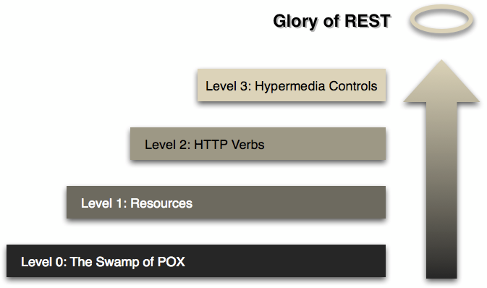
REST – Richardson’s Maturity Model

Slide 6
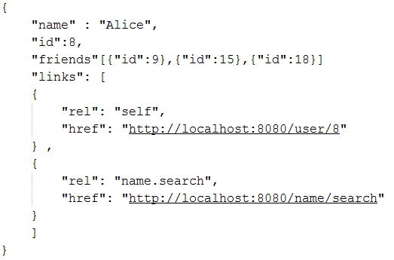
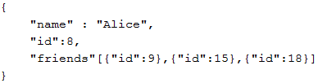
REST
Hypermedia as the engine of application state (HATEOAS)
A hypermedia-driven site provides information to navigate the site's REST interfaces dynamically by including hypermedia links with the responses.
Helping client to navigate the API with Hypermedia links
No Hypermedia
Ref: Understanding HATEOAS

Slide 7
REST architectural style - Drivers
Heterogeneous Interoperability & Rise of Mobile
Service (API) providers cannot make any assumptions about the client platforms.
The client could be a browser, a mobile device running any OS, a GPS navigator, automotive system or anything else
Clients and Services need to evolve independently.
Each Client could be running a unique native OS and could be deployed at varied times independent of the Service
Latency issues, performance, reliability are major issues for Mobile platforms
Horizontal Scalability – It is critical to build a scalable architecture in order to take advantage of a scalable infrastructure
Ref: REST fundamentals – Howard Dierking

Slide 8
Micro-services architectural style
Developing a single application as a suite of small services, each running in its own process and communicating with lightweight mechanisms, often an HTTP resource API.
Reference: http://martinfowler.com/articles/microservices.html

Slide 9
Micro-services architectural style
Characteristics:
Componentization via Services
Organized around Business Capabilities
Products not Projects
Smart endpoints and dumb pipes
Decentralized Governance
Decentralized Data Management
Infrastructure Automation
Design for failure
Evolutionary Design
Reference: http://martinfowler.com/articles/microservices.html
Notes:
component is a unit of software that is independently replaceable and upgradeable.

Slide 10
Spring Framework
REST principles

Slide 11
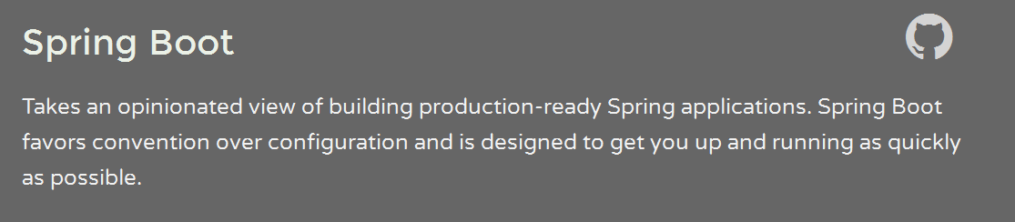
Primary goals:
Rapid development
Opinionated out of the box
Provide a range of non-functional features
No requirement for XML configuration.
Notes:
Spring Boot makes it easy to create stand-alone, production-grade Spring based Applications that you can “just run”.
take an opinionated view

Slide 12
Convention over Configuration
DRY Principle – Do not repeat yourself!
Start with sensible defaults
You should only have to configure something to use it for customization (non default setting).
Example: Did you include Logback in the classpath? Spring Boot will assume that you want to use it and will attempt to configure it.
Notes:
Example:

Slide 13
Hello world with Spring Boot

